Slide 1
Solving Problems by Searching

Slide 2
Chapter’s Outline
Problem Solving Agents
Well Defined Problems and Solutions
Example Problems
Searching for Solutions
Infrastructure of Search Algorithms
Performance Metric
Uninformed Search Strategies
Informed (Heuristic) Search Strategies
2

Slide 3
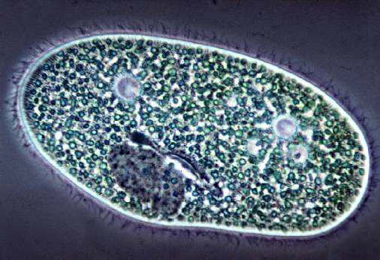
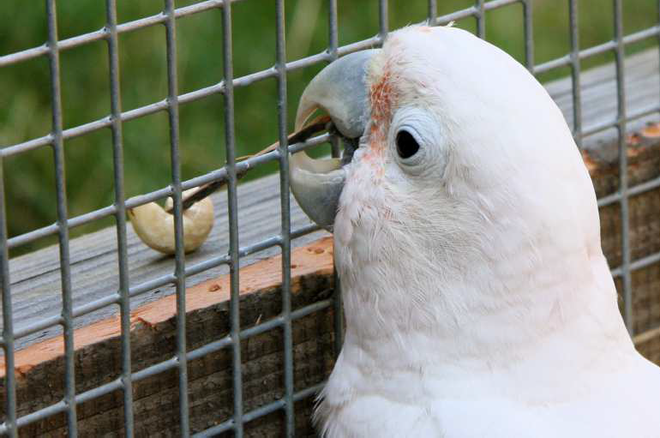
Types of agents
Reflex agent
Planning agent
Consider how the world IS
Choose action based on current percept
Do not consider the future consequences of actions
Consider how the world WOULD BE
Decisions based on (hypothesized) consequences of actions
Must have a model of how the world evolves in response to actions
Must formulate a goal

Slide 4
Problem
A farmer wants to get his cabbage, goat, and wolf across a river. He has a boat that only holds two. He cannot leave the cabbage and goat alone or the goat and wolf alone. How many river crossings does he need?
- 4
- 5
- 6
- 7
- no solution

Slide 5
Solution
The wolf does not eat cabbage, so the crossing can start with the goat.
The man leaves the goat and returns, puts the cabbage in the boat and takes it across. On the other bank, he leaves the cabbage but takes the goat.
He leaves the goat on the first bank and takes the wolf across. He leaves the cabbage with the wolf and rows back alone.
He takes the goat across.

Slide 6
Intuition
When you solve this problem, try to think about how you did it.
Simulated the scenario mentally. Considered sending the farmer over with the goat.
Observed the consequences. Checked if anything got eaten
If nothing was eaten, proceeded with the next action
If something got eaten, undid that move .Tried an alternative action
But the point is not for you to be able to solve this one problem manually.
To enable machines to solve problems systematically, a structured/systematic approach is required that considers all possibilities.
Search problems define these possibilities, and search algorithms are designed to systematically explore them to find solutions.

Slide 7
Search
We will consider the problem of designing agents in fully observable, deterministic, discrete, known environments
The agent must find a sequence of actions that reaches the goal.
The performance measure is defined by
Reaching the goal and
How “expensive” the path to the goal is
– We are focused on the process of finding the solution; while executing the solution, we assume that the agent can safely ignore its percepts.

Slide 8
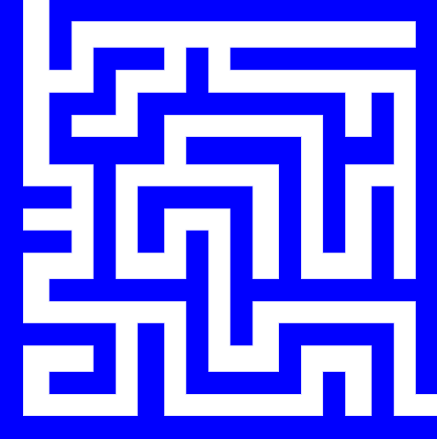
Search problem components
Initial state
Actions
Transition model
What state results from performing a given action in a given state?
Goal state
Path cost
Incurred when moving from one state to another after applying an action
The optimal solution is the sequence of actions that gives the lowest path cost for reaching the goal
Initial state
Goal state

Slide 9
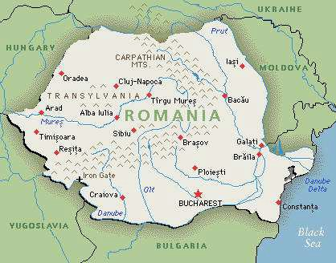
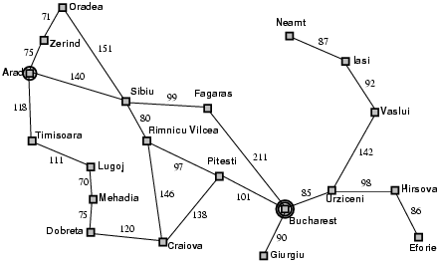
Example: Romania
On vacation in Romania; currently in Arad
Flight leaves tomorrow from Bucharest
Initial state
Arad
Actions
Go from one city to another
Transition model
If you go from city A to city B, you end up in city B
Goal test
Is state == Bucharest
Path cost
Sum of edge costs (total distance traveled)

Slide 10
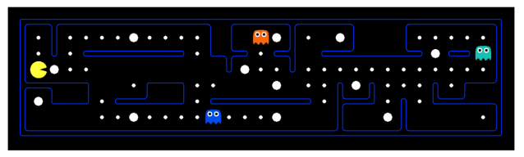

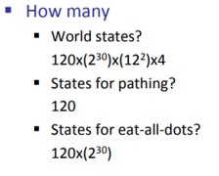
State space
The initial state, actions, and transition model define the state space of the problem
The set of all states reachable from initial state by any sequence of actions.
Distinguish between world state and Search state
The world state includes every last detail of the environment.
Notes:
So, the total number of possible world states is:
2^4=2×2×2×2=16
This means there are 16 different possible configurations or states that the game world can be in when considering 4 locations. Each configuration represents a unique combination of which locations are occupied and which are not.

Slide 11
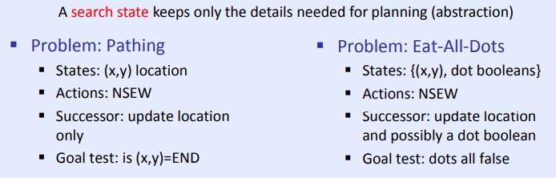
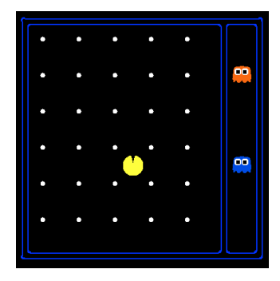
State space
Consider a variation of the game in which the maze contains only Pacman and food pellets.
We can pose two distinct search problems in this scenario: pathing and eat-all-dots
For pathing, states contain less information than states for eat-all-dots
For eat-all-dots we must maintain an array of booleans corresponding to each food pellet and whether or not it’s been eaten in the given state
Notes:
So, the total number of possible world states is:
2^4=2×2×2×2=16
This means there are 16 different possible configurations or states that the game world can be in when considering 4 locations. Each configuration represents a unique combination of which locations are occupied and which are not.

Slide 12
Abstraction
Definition:
Process of removing irrelevant detail to create an abstract representation: ``high-level”, ignores irrelevant details
Navigation Example: how do we define states and operators?
First step is to abstract “the big picture”
i.e., solve a map problem
nodes = cities, links = freeways/roads (a high-level description)
this description is an abstraction of the real problem
Can later worry about details like scenery, refueling, etc
Abstraction is critical for automated problem solving
must create an approximate, simplified, model of the world for the computer to deal with: real-world is too detailed to model exactly
good abstractions retain all important details

Slide 13
State-Space Problem Formulation
A problem is defined by following items:
Initial state e.g., "at Arad“
Actions or successor function
S(x) = set of action–state pairs
e.g., S(Arad) = {<Arad , Zerind>,<Arad, Timisoara>, … }
Function S(x) takes a state x as input and returns a set of action-state pairs
3. Goal test (or set of goal states)
e.g., x = "at Bucharest”, Checkmate(x)
Transition model: Result(s,a)
how the state changes when an action is taken. The result(s,a) represents the state that results from taking action a in state s.
Path cost (additive)
e.g., sum of distances, number of actions executed, etc.
c(x,a,y) is the step cost, assumed to be ≥ 0
A solution is a sequence of actions leading from the initial state to a goal state

Slide 14
Example: Traveling Salesperson Problem
Find the shortest tour that visits all cities without visiting any city twice and return to starting point.
State: sequence of cities visited
S₀ = A
C
B
A
D
F
G = a complete tour
E
15

Slide 15
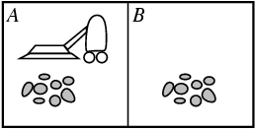
Example: Vacuum world
States
Agent location and dirt location
How many possible states?
What if there are n possible locations?
The size of the state space grows exponentially with the “size” of the world!
Actions
Left, right, suck
Transition model

Slide 16
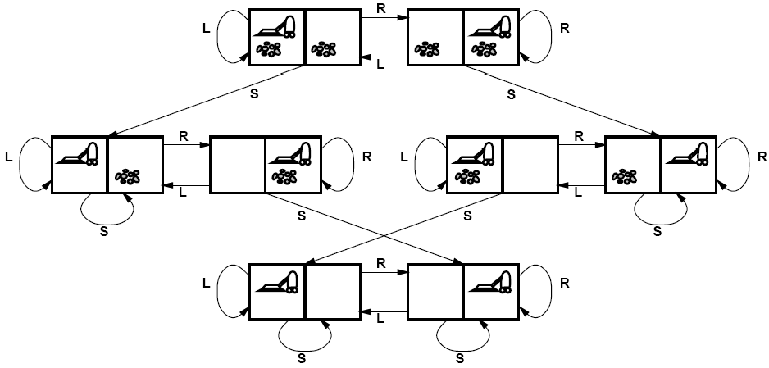
Vacuum world state space graph

Slide 17
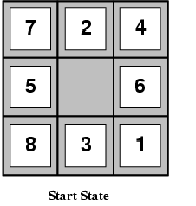
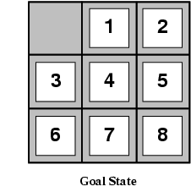
Example: The 8-puzzle
States
Locations of tiles
• 8-puzzle: 181,440 states (9!/2)
15-puzzle: ~10 trillion states
24-puzzle: ~10²⁵ states
Actions
Move blank left, right, up, down
Path cost
1 per move

Slide 18
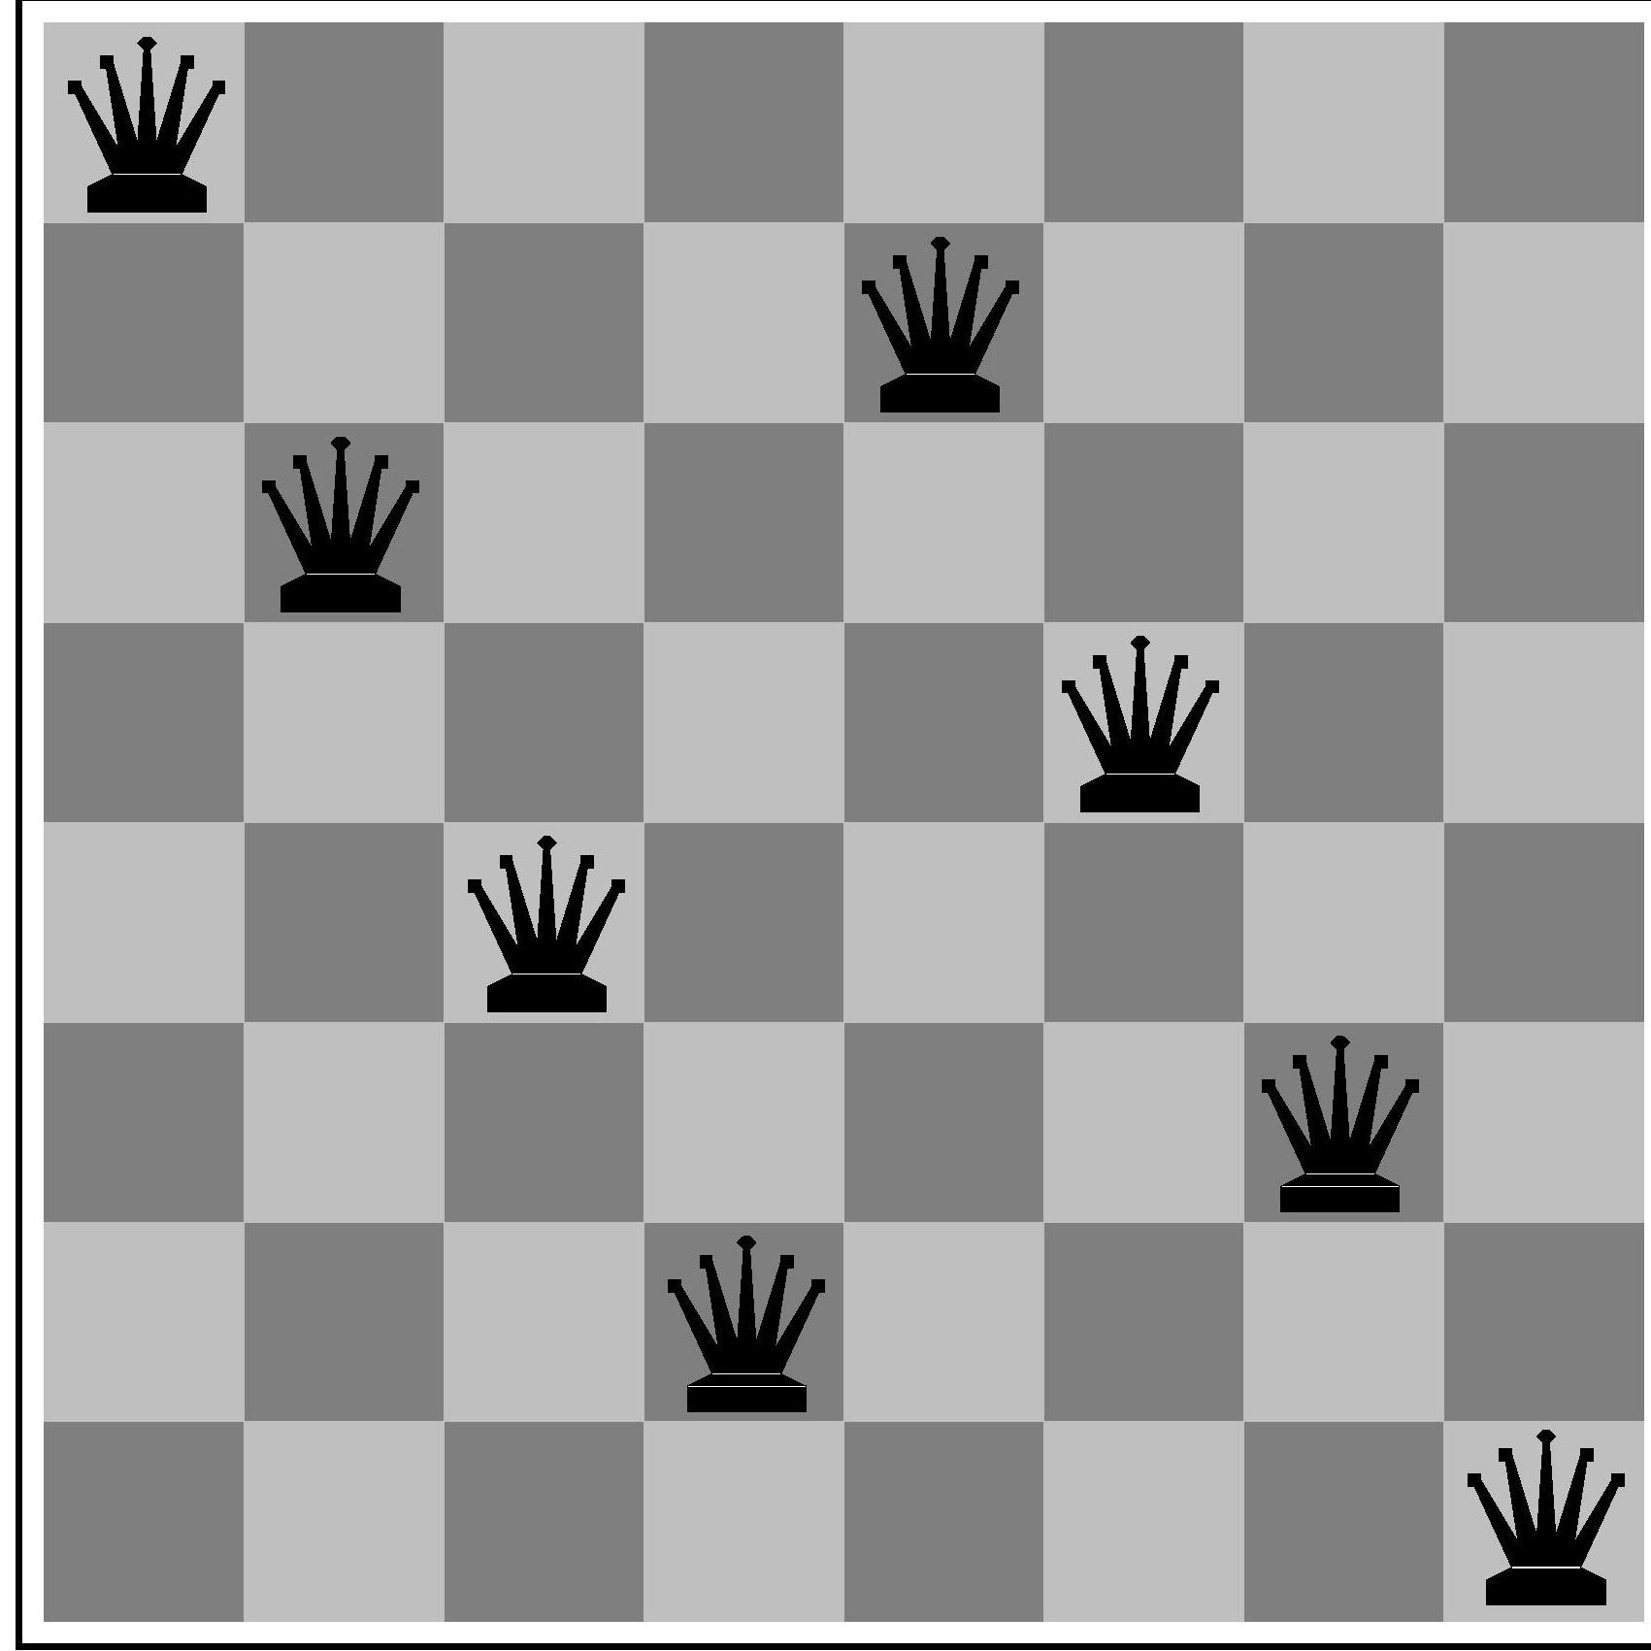
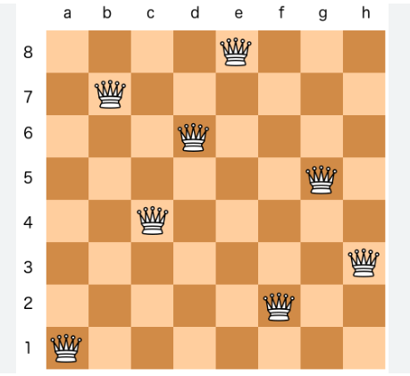
State-Space problem formulation
initial state? no queens on the board
actions?
-add queen to any empty square
-or add queen to leftmost empty square such that it is not attacked by other queens.
goal test? 8 queens on the board, none attacked.
path cost? 1 per move

Slide 19
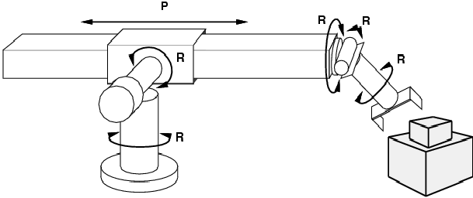
Example: Robot motion planning
States
Real-valued joint parameters (angles, displacements)
Actions
Continuous motions of robot joints
Goal state
Configuration in which object is grasped
Path cost
Time to execute, smoothness of path, etc.

Slide 20
How to represent State Space

Slide 21
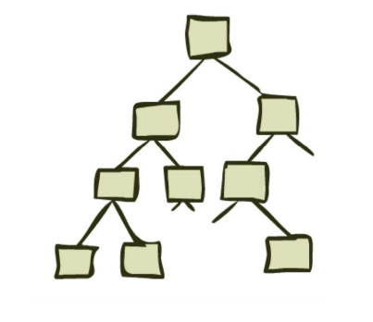
Search problem solution
State Space Graphs and Search Trees

Slide 22
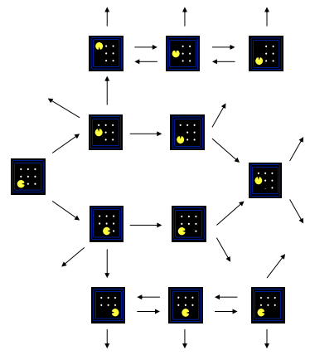
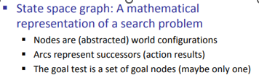
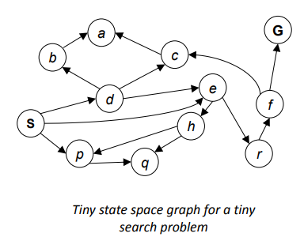
Representing Search
Can be represented as a directed graph where the nodes are states and links between nodes are actions
We search for a solution by building a search tree and traversing it to find a goal state

Slide 23
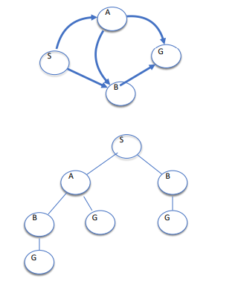
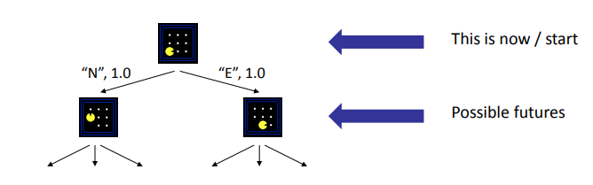
Search tree
The root node corresponds to the starting state
The children of a node correspond to the successor states of that node’s state
A path through the tree corresponds to a sequence of actions
– A solution is a path ending in the goal state

Slide 24
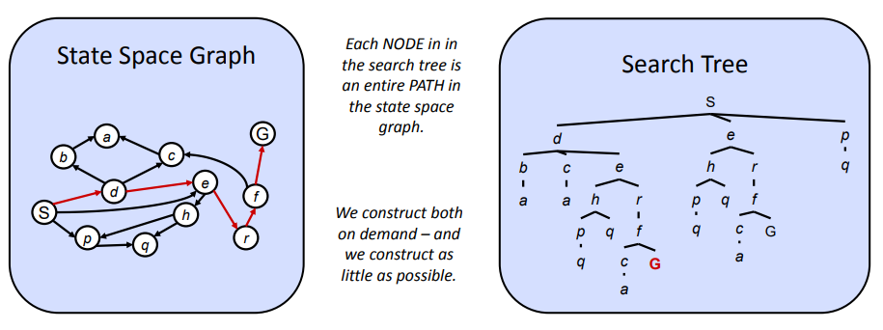
State Space Graphs vs. Search Trees

Slide 25
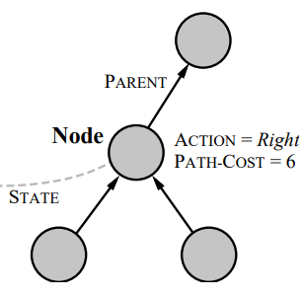
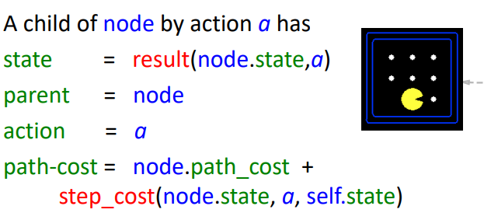
States versus Nodes
A state is a (representation of) a physical configuration
A node is a data structure constituting part of a search tree contains info such as: state, parent node, action, path cost g(x), depth
node.path_cost
The total cost it took to reach the current node from the start.
step_cost(node.state, a, self.state)
The additional cost of taking action a from the current state (node.state) to reach the next state (self.state).
new path cost = old path cost + cost of the step just taken.

Slide 26
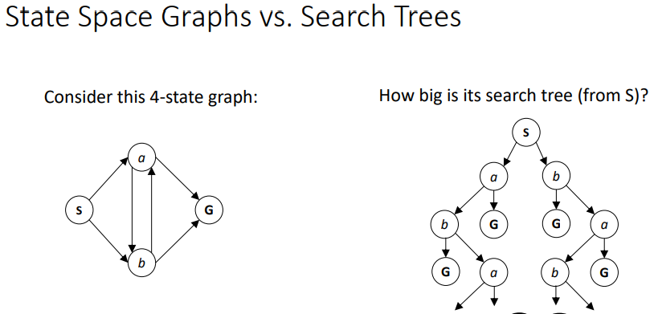
State space graph = defines the problem (all states + transitions).
Search tree = defines the process (all paths the algorithm actually explores).

Slide 27
Search: Basic idea
Let’s begin at the start state and expand it by making a list of all possible successor states.
Maintain a frontier or a list of unexpanded states
At each step, pick a state from the frontier to expand
Keep going until you reach a goal state
Try to expand as few states as possible

Slide 28
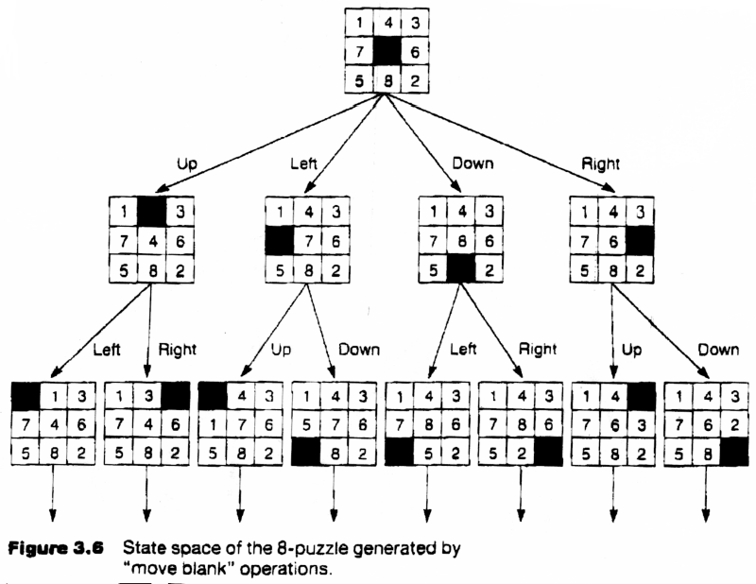
Search Tree for the 8 puzzle problem

Slide 29
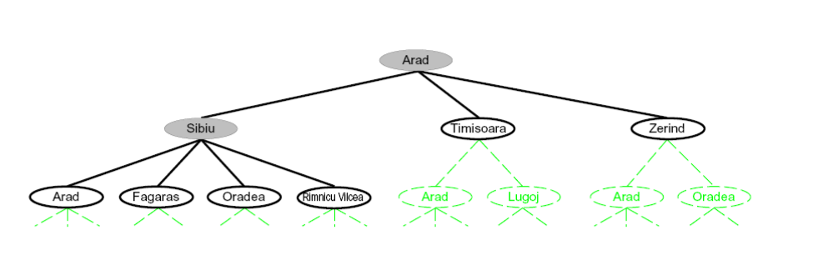
Romania Search Tree

Slide 30
Search Tree vs Tree Search
Search Tree:
A search tree is a data structure that represents the exploration of a search problem.
It is built from the state space graph.
Tree Search:
A tree search is a search algorithm strategy that explores the search tree.
It systematically traverses the tree, considering different paths by choosing nodes to expand and visit next
.
A search tree holds the information, while tree search is the strategy to navigate through that information to find the desired solution. They are two parts of the same problem-solving process.

Slide 31
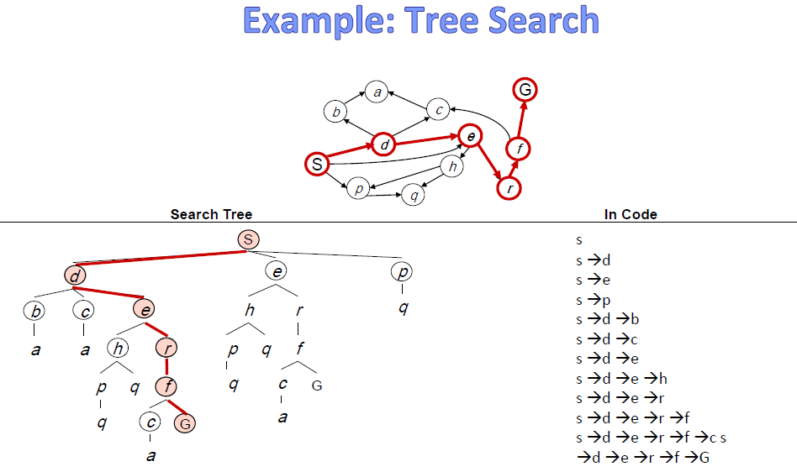

Slide 32
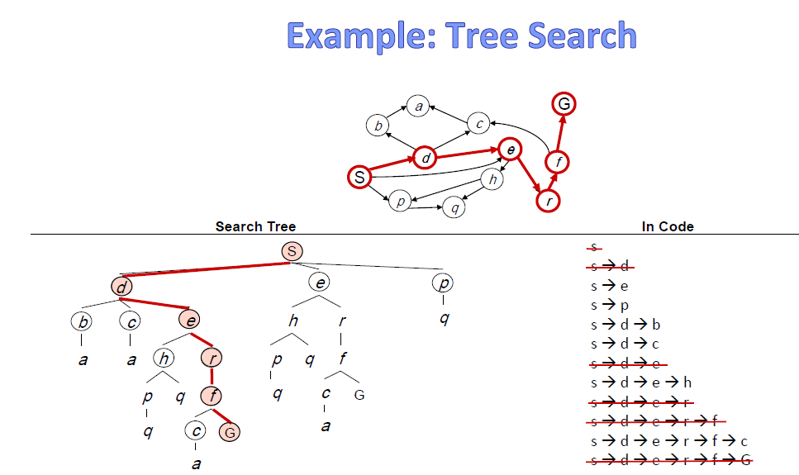

Slide 33
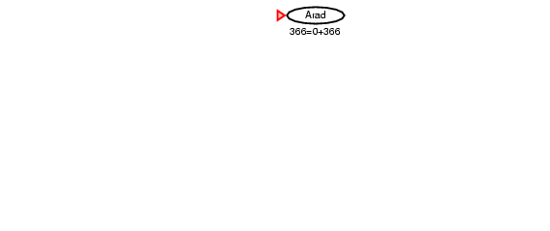
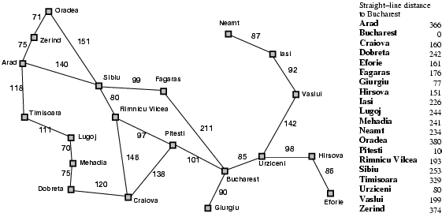
Tree search example
Start: Arad Goal: Bucharest

Slide 34
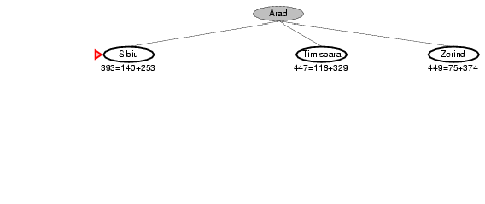
Tree search example
Start: Arad Goal: Bucharest

Slide 35
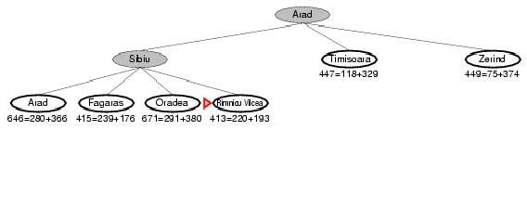

Tree search example
Start: Arad Goal: Bucharest

Slide 36
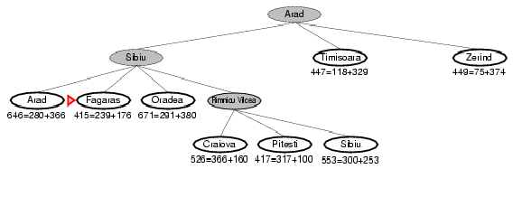

Tree search example
Start: Arad Goal: Bucharest

Slide 37
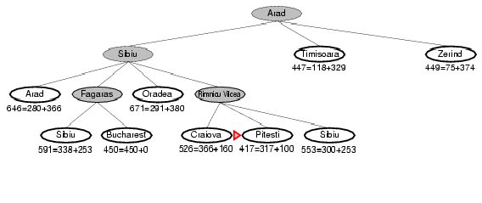
Tree search example
Start: Arad Goal: Bucharest

Slide 38
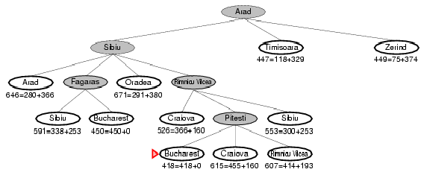
Tree search example
Start: Arad Goal: Bucharest

Slide 39
Tree search example
Start: Arad Goal: Bucharest

Slide 40
Handling repeated states
Initialize the frontier/fringe using the starting state
While the frontier is not empty
Choose a frontier/fringe node according to search strategy and take it off the frontier/fringe
If the node contains the goal state, return solution
Else expand the node and add its children to the frontier
To handle repeated states:
Every time you expand a node, add that state to the
explored set; do not put explored states on the frontier again
Every time you add a node to the frontier, check whether it already exists in the frontier with a higher path cost, and if yes, replace that node with the new one

Slide 41
Search without repeated states
Start: Arad Goal: Bucharest

Slide 42
Search without repeated states
Start: Arad Goal: Bucharest

Slide 43
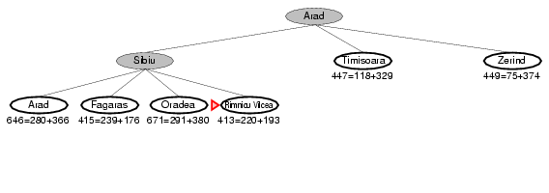
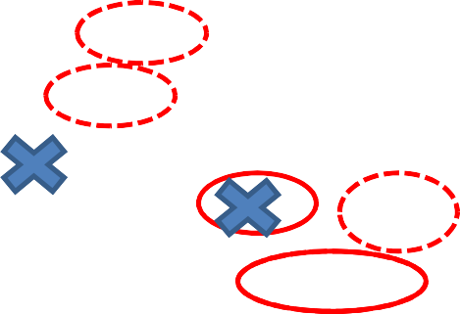
Search without repeated states
Start: Arad Goal: Bucharest

Slide 44
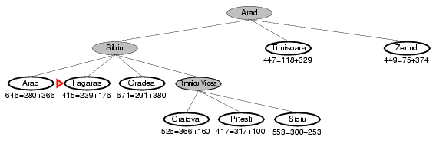
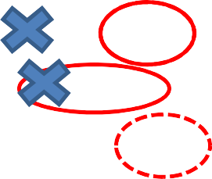
Search without repeated states
Start: Arad Goal: Bucharest

Slide 45
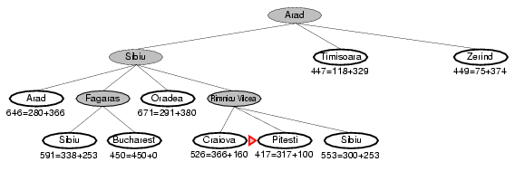
Search without repeated states
Start: Arad Goal: Bucharest

Slide 46
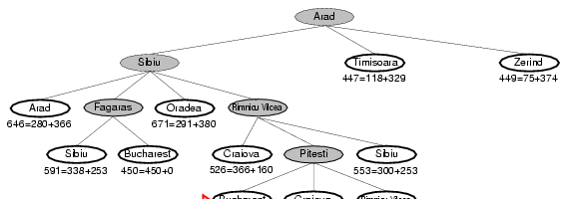
Search without repeated states
Start: Arad Goal: Bucharest

Slide 47
Search without repeated states
Start: Arad Goal: Bucharest

Slide 48
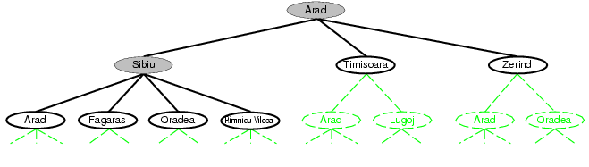
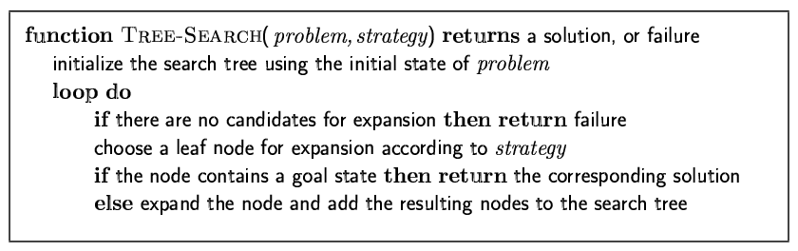
Tree Search Algorithm
44

Slide 49
Tree Search Algorithm
This “strategy” is what differentiates different search algorithms
45

Slide 50
The End
48

